Slide 1
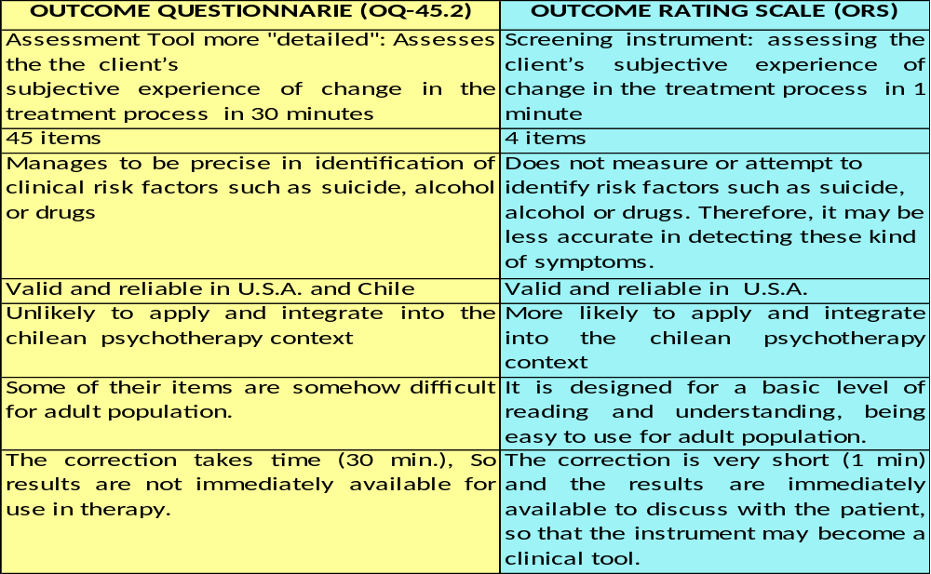
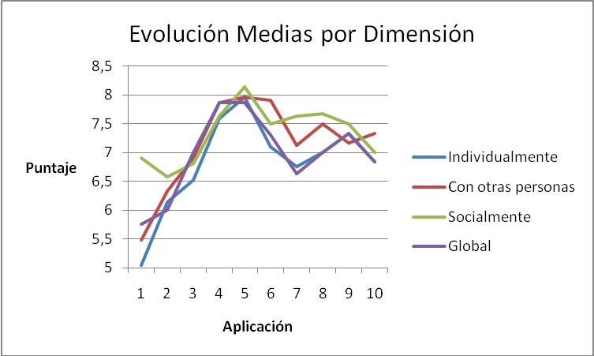

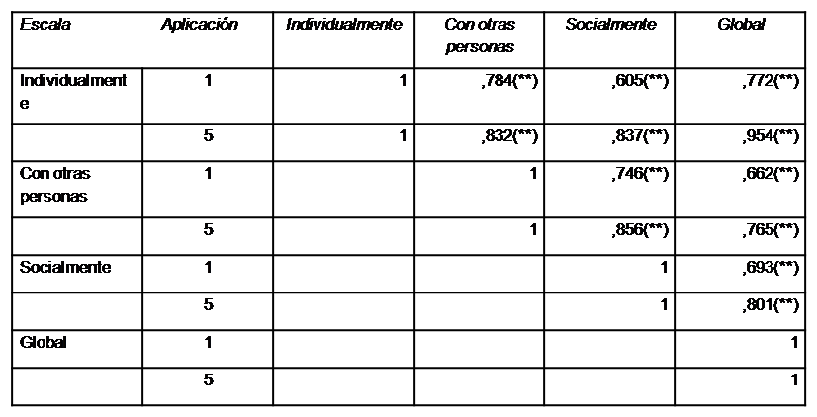
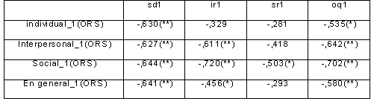

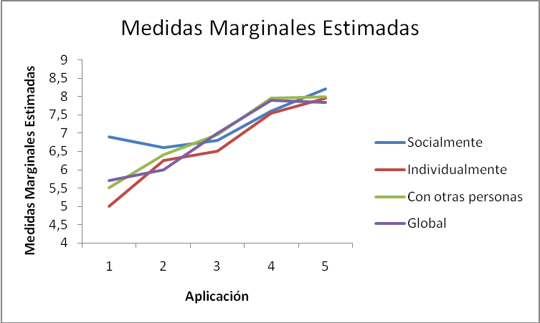
CHILEAN ADAPTATION AND VALIDATION OF THE OUCOME RATING SCALE (ORS)
I N T R O D U C TION
ADAPTATION
-Spanish-English translation of test ORS
- Review by a panel of experts therapists and
methodologists.
- Spanish-English retranslation
- Final version Validation by Duncan and Miller
- Retranslation into Spanish.
PROCEDURE
VALIDATION
-Alliance with another thesis team by validating
SRS test (in contrast to test IAT) to facilitate
sample collection.
- Contact with therapists (belonging to
mental health centers and independent)
Based on Eysenck`s studies (1952), a change in the research of the several theoretical approaches in psychotherapy has started, beginning to focus on the effectiveness of the psychotherapeutic process.
"Instead of assuming that the right process leads to favorable results, it is necessary to use these results to build and guide the therapeutic process”. (Duncan and Miller, 2000)
In this context, the need of developing tools to assess the client’s subjective experience of change in the treatment process comes out. Based on what has been already stated, the Outcome Rating Scale (ORS) was created by Duncan and Miller in 2000, based on the Outcome Questionnaire (OQ-45.2).
The advantages and disadvantages of both tests are:
What's happening in our country?
Within the tests validated in Chile to assess the client’s subjective experience of change in the treatment process , one of them is the questionnaire OQ-45.2. This questionnaire, which was validated in 2002, by De La Parra, Von Bergen and Del Rio, has been used since then. Managing to be precise in the evaluation of the client’s subjective experience of change in the treatment process.
However, it is necessary to validate an instrument in Chile acting as a "screening" on the client's perception of change in the treatment Process. It allows greater implementation feasibility, especially in the chilean context of psychotherapy in both private and public institutions.
Counting on these fast and simple tests, they allow minimal impact on process of psychotherapy and also allow better integration of research to the psychotherapy.
I. General Objetive
To adapt and validate the assessment tool results (ORS) to use in the
Chilean population.
II. Specific Objectives
1. To adapt the ORS Items to the social and cultural reality from a Chilean
linguistic and semantic point of view.
2.To assess the reliability of the adapted instrument.
3.To assess the validity of the adapted instrument:
Content Validity
Construct validity
Concurrent validity
Sensitivity to change
SAMPLE RECOLECTION
  DIFFICULTIES
  Loss of much of the sample due to:
  High resistance of therapists, supervisors and institutions
  because of the fear of being evaluated by the patient.
  - Implementation process seems long and tedious.
  - Neglect of the material from the therapists.
  - Therapy abandonment.
  - Some consent letters were not signed.
MONITORING OF SAMPLE IMPLEMENTATION
PROCEDURE
-Delivery of 250 kits and training to therapists.
Content folders:
- Patient´s authorization letter
- Guideline for use of tests
- 10 Copies test ORS
- 10 copies SRS test
- 3 copies IAT test
- 3 copies test OQ-45.
FINAL SAMPLE(n:22)
STATISTICAL ANALYSIS
- Reliability analysis (Cronbach Alpha)
- Validity Analysis
Content Validity
Construct validity: correlation interescale
Convergent validity: Pearson correlation with OQ-45.2.
Evolution of time-varying analysis
Fig. 2: Procedure
R E S U L T S
Sample comportament
There were not statistically significant differences between the ages of men 35.12 (M: 34.2, DE: 11.9) and women 34.71 (M: 31.9, DE: 10.3) who participated in this research ( p = 0.446).
The scores distribution is clustered around
half the scale (score 5 on a scale from 0 to10),
with standard deviations of 2.5 points. It is
observed an increase in scores through the
applications and the stabilization of themselves,
specifically from the fifth application
Tabla 1: Índices de Confiabilidad test ORS Reliability
The total reliability of the instrument was calculated through
Alpha Cronbach´s technique. The results indicate appropriate
reliability ranges with a value of 0.905 for the 1st application.
Table 2: Inter-Scale Correlations for the First and Fifth Application
Construct validity (Inter-Scale Correlations)
The correlation of the different scales was calculated
as a measure of homogeneity in the test. The
results show positive significant correlations with
p <0.05 among all scales, ranging from rxy =. 605 until
rxy =. 995. On the right side of the page, the correlations
Inter-Scale for the1st and the 5th application.
Table 3: Pearson correlation between ORS and OQ-45.2 for the Fist Aplication
Concurretnt validity (with respect to OQ-45.2)
The analysis of the association between the ORS scores and
OQ-45.2 are shown in the first application. For this,
measurements with the correlation test and Pearson
correlations were carried out and correlations were obtained. on all scales According to the reduced N (6), for the tenth application, it
was chosen the use of Spearman's indicator of
Tablle 4: Comparisson between ORS validation in USA and Chile association and the ones obtained were in the scales: Individually and With Others.
Sensitivity to change over time
There are differences in measurements for intra –individuals
for each dimension. That is why, it can be stated that the test is
sensitive to change in different scales over time.
O B J E C T I V E S
M E T HO D
C O N C L U S I O N
I. Methodology
This is a quantitative psychometric research. The sampling strategy was non-probabilistic and accidental. It was used a sample of therapeutic processes among Chilean patients from the metropolitan area. They were all over 18 years old, from both sexes and were consulted in public or private psychological institutions. In this regard, therapeutic processes were evaluated in relation to the patient, not patient-therapist dyads. The final sample was from 22 participants (8 men and 14 women).
People who didn't authorize the use of their results in the study or those who were not trained to answer the test, because of disturbances, psychotic episodes, or addictive disorders, were excluded from the sample. There was also another exclusion criteria, which consisted in having previously consulted to that therapist. All subjects voluntarily agreed to participate in the study, obtaining informed consent and approval of relevant ethics committees of the institutions concerned.
IV. Procedure
The subjects completed the ORS and OQ-45.2 (used as a contrast measure). The psychometric characteristics of ORS and its correlation with the OQ-45.2 were evaluated through statistical analysis of the results.
The results confirm that:
The ORS scale is adapted to the Chilean reality from a linguistic and semantic point of view.
The scores showed an evolution from the 1st to the 5th session, where it reaches the highest score, and then leveled off at around 7 points from the seventh session onwards.
ORS scale in this application is reliable (Cronbach's Alpha 0,905-0,954)
The ORS provides a level of content construct and convergent validity, (between 0.5 and 0.58) respect to the
OQ -45.2 and it is sensitive to change over time.
The information obtained is consistent with the results obtained by the authors who studied reliability and validity of the ORS test in the American population. (0.93 reliability and concurrent validity 0.5 and 0.69)
Therefore, it is possible to conclude that the ORS is a valid instrument to be used in the Chilean population.
LIMITATIONS
The sample is not too large, and this may affect the fact that the correlation with the OQ-45.2 is not significant for all scales in all applications.
DIFFICULTIES
- The battery of tests requires a long time to apply.
The therapists’ resistance to use the test because it might affect the therapeutic alliance.
PROPOSALS FOR THE FUTURE
- It is suggested to continue with this study, increasing the amount of the sample, implementing methods to reduce experimental mortality. Also to perform other tests to enhance the validity of the instrument, such as a factor analysis ,to take more details and correct the lower correlations found with the OQ-45.2.
Cecilia Donoso Guillen- María Alejandra Grez Valdés
Psychology School, Universidad Gabriela Mistral, Chile

